Slide 1
Journal Finder
Yanxi Lu Who
11/10/2017

Slide 2
Introduction
Finding the journals that could be best suited for publishing your paper
Input: Your Abstract
Output: Journals best suited to your articles
Output: Similar Abstracts to your articles
Assumed “the best suited” means “the most similar”
Journal
Article 1
Article 2
Journal
Article 1
Article 2
Journal
Article 1
Article 2
Input
Journal
Article 1
Article 2
Journal
Article 1
Article 2

Slide 3
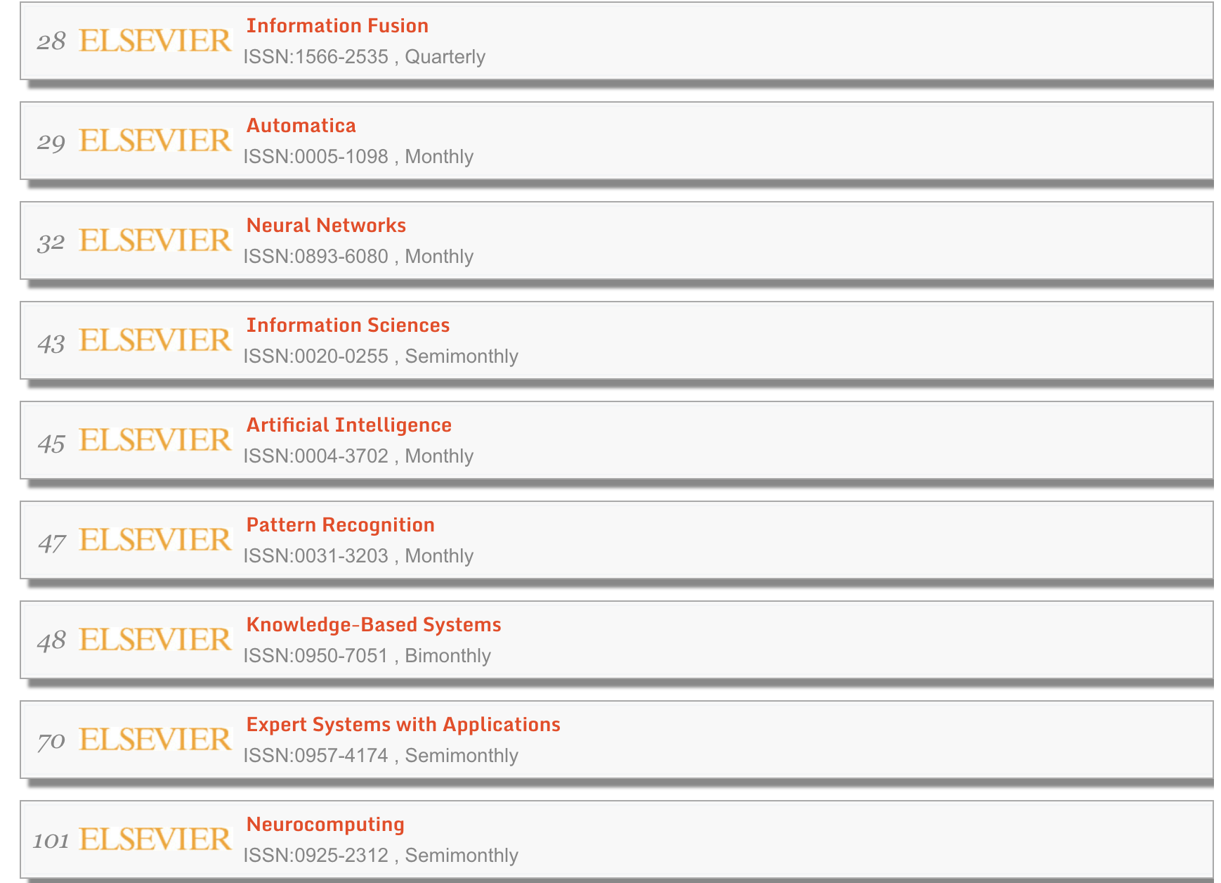
Database
The Journal articles on Machine Learning from 2000-2017
~8000 Abstracts, ~15 Journals from ELSEVIER
Scraped by ELSEVIER API
Titles of research papers
Abstracts
Key words

Slide 4
Method
Comparing similarities between input abstract and each abstract from the journals.
Journal 1:
Abstract 1
Abstract 2
Abstract 3
…
Averaged Similarity Ratio 1
Abstract
…
Journal n:
Abstract 1
Abstract 2
Abstract 3
…
Averaged Similarity Ratio N

Slide 5
Method
Document Vector in Word Space ------ Cosine Similarity
TFIDF ----- LSI
Word2Vector Model
Document Vector in Topic Space ------ Cosine Similarity
LDA

Slide 6
Method
2. Classification
TFIDF
LDA
 | Word 1 | Word 2 | Word 3 | Word4 | Topic 1 | Topic 2 | Topic 3 | Class
Abstract 1 |  |  |  |  |  |  |  | Journal 1
Abstract 2 |  |  |  |  |  |  |  | Journal 1
Models: Random Forest Classifier, Logistic regression, Gradient Boosting
Input Abstract
?

Slide 7
Result
Comparing similarities:
Word2Vector Based on Google Model
Flask App
Classification Model: Random Forest
Precision: 0.87
Recall: 0.85
F1 Score 0.85

Slide 8
Future Work
Expanding the database, adding more journals and abstracts.
Analyzing the topics of the journals.

Slide 9
Thank you!

